Slide 1
Accounting Cycle
Generalizing, Ledger, Trail Balance and Financial Statements

Slide 2
Learning Objectives
Identify the steps in Accounting Cycle
Understanding he concept of ‘Double Entry Concept’
What are the elements of accounting?
Understanding the term ‘Debit’ and ‘Credit’
The Journal (General and Specific) and the process of Journalizing
The Balancing of Ledger and the Trial balance
Financial Statement and Balance Sheet

Slide 3
Accounting Cycle
The sequence of accounting procedures used to
Record
Classify
and summarize accounting information
in financial reports
at regular intervals is often termed the accounting cycle

Slide 4
Accounting Cycle
The accounting cycle begins with the initial recording of business transactions
It concludes with the preparation of a complete set of formal financial statements
The term cycle indicates that these procedures must be repeated continuously
It enable the business to prepare new, up-to date financial statements at reasonable intervals.

Slide 5
The Role of Accounting Records
The cyclical process of collecting financial information and maintaining accounting records does far more than facilitate the preparation of financial statements rather managers and employees use the information stored in Accounting records for some purposes such as,
Establishing accountability for the assets and/or transactions under an individual’s control.
Keeping track of routine business activities. (cash available, creditors and debtors)
Obtaining detailed information about a particular transaction.
Evaluating the efficiency and performance of various departments within the organization.
Maintaining documentary evidence of the company’s business activities

Slide 6
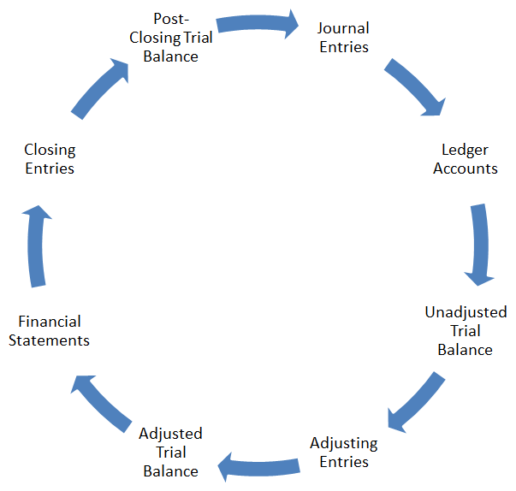
Accounting Cycle

Slide 7
Double Entry System: THE EQUALITY OF DEBITS AND CREDITS
Assets = Liabilities + Owners’ Equity
Debit Balance Credit Balance
The double entry system of accounting define as “recording transactions having two fundamental aspects
The receiving of a benefit
To giving the benefit
The double entry system recognize the dual aspect concept
That is two accounts always affected by each transactions
Every Debit has an equal and offsetting Credit

Slide 8
Advantages of Double Entry System
A complete record of all transactions maintained systematically
Financial position of a business and profit and loss of a firm is ascertained
Location and rectification of errors are possible
Consistency in the books of accounts can be maintained
Amount payable and receivable is easily ascertained
Cash balance at any point of time is easily available

Slide 9
Elements of Accounting
Five elements of accounting
Assets: are economic resources that are owned by a business and are expected to benefit future operations
Liabilities: are financial obligations or debts. The person or organization to whom the debt is owed is called a creditor
Proprietorship (Owner’s Equity) : represents the owners’ claims on the assets of the business
Revenue : Revenue is the price of goods sold and services rendered during a given accounting period
Expenses : are the costs of the goods and services used up in the process of earning revenue e.g. salaries, rent

Slide 10
Debit and Credit Definition
Every transaction has two aspects in accounting
Debit and Credit
Debit and credit are Statements in accounting
Debit didn’t means an increase and
Credit didn’t means a decrease
Debit refers to the left side of any account while Credit refers to the right side of any account

Slide 11
Rules of Debit and Credit
To understand the accounting process it is necessary to understand
Accounting equation and Rules of debit and credit
Increase Assets Decrease
Increase Expenses Decrease
Decrease Liabilities Increase
Decrease Proprietorship Increase
Decrease Revenue Increase
Debit | Nature of Account | Credit

Slide 12
The Journal
The chronological (day by day) record of business transactions
Every transaction is settled down with relevant detail
It is the primary book in which transactions are recorded
Each record in the journal is called an Entry
The process of recording transactions in particular accounts is known as Journalizing
Two types of Journal is there
General (General Journal) and Specific (cash book, Purchase and sales journal etc.)

Slide 13
Specimen of General Journal
ABC CORPORATIONS
General Journal
For the month of January 2018
Date | Description/Particulars | P/R | Debit | Credit

Slide 14
Steps in Journalizing
Identify the account involved
Determine the nature of account
Apply rules for debit and credit
Identify which account is debited and credited
Record date of transaction
Write short narration in brackets in particular or description column
Draw a line which shows the end of an entry

Slide 15
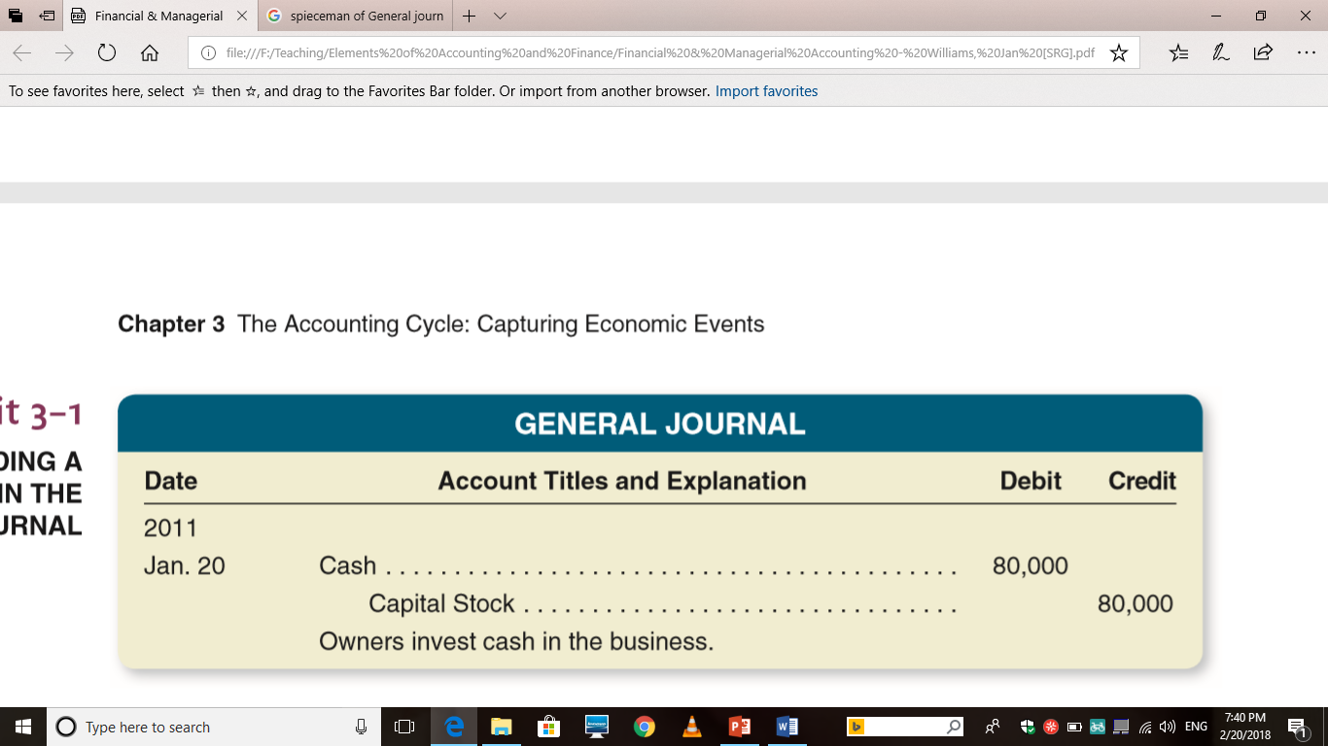
General Journal Recording

Slide 16
The Ledger
An AS includes a separate record of for each item that appears in accounting records
The record used to keep track of the increase and decrease in accounts is termed as ledger account or account
Leger define as;
The entire collection of all accounts debited or credited in the journal or its subsidiary books. Or
The entire group of accounts is kept together in an accounting record called ledger.

Slide 17
Forms of Ledger Account
Two forms of leger account
Standard (T account or skeleton) Ledger
Running Balance (self balancing) Ledger

Slide 18
Ledger Specimen
Standard Ledger
ABC CORPORATIONS
General Ledger
For the month of January 2018
Title of Account
Cr.
Dr.
Date | Description/Particulars | P/R | Amount | Date | Description/Particulars | P/R | Amount

Slide 19
Ledger Specimen
Self Balancing
ABC CORPORATIONS
General Ledger
For the month of January 2018
Title of Account
Date | Description/Particulars | P/R | Debit | Credit | Balance

Slide 20
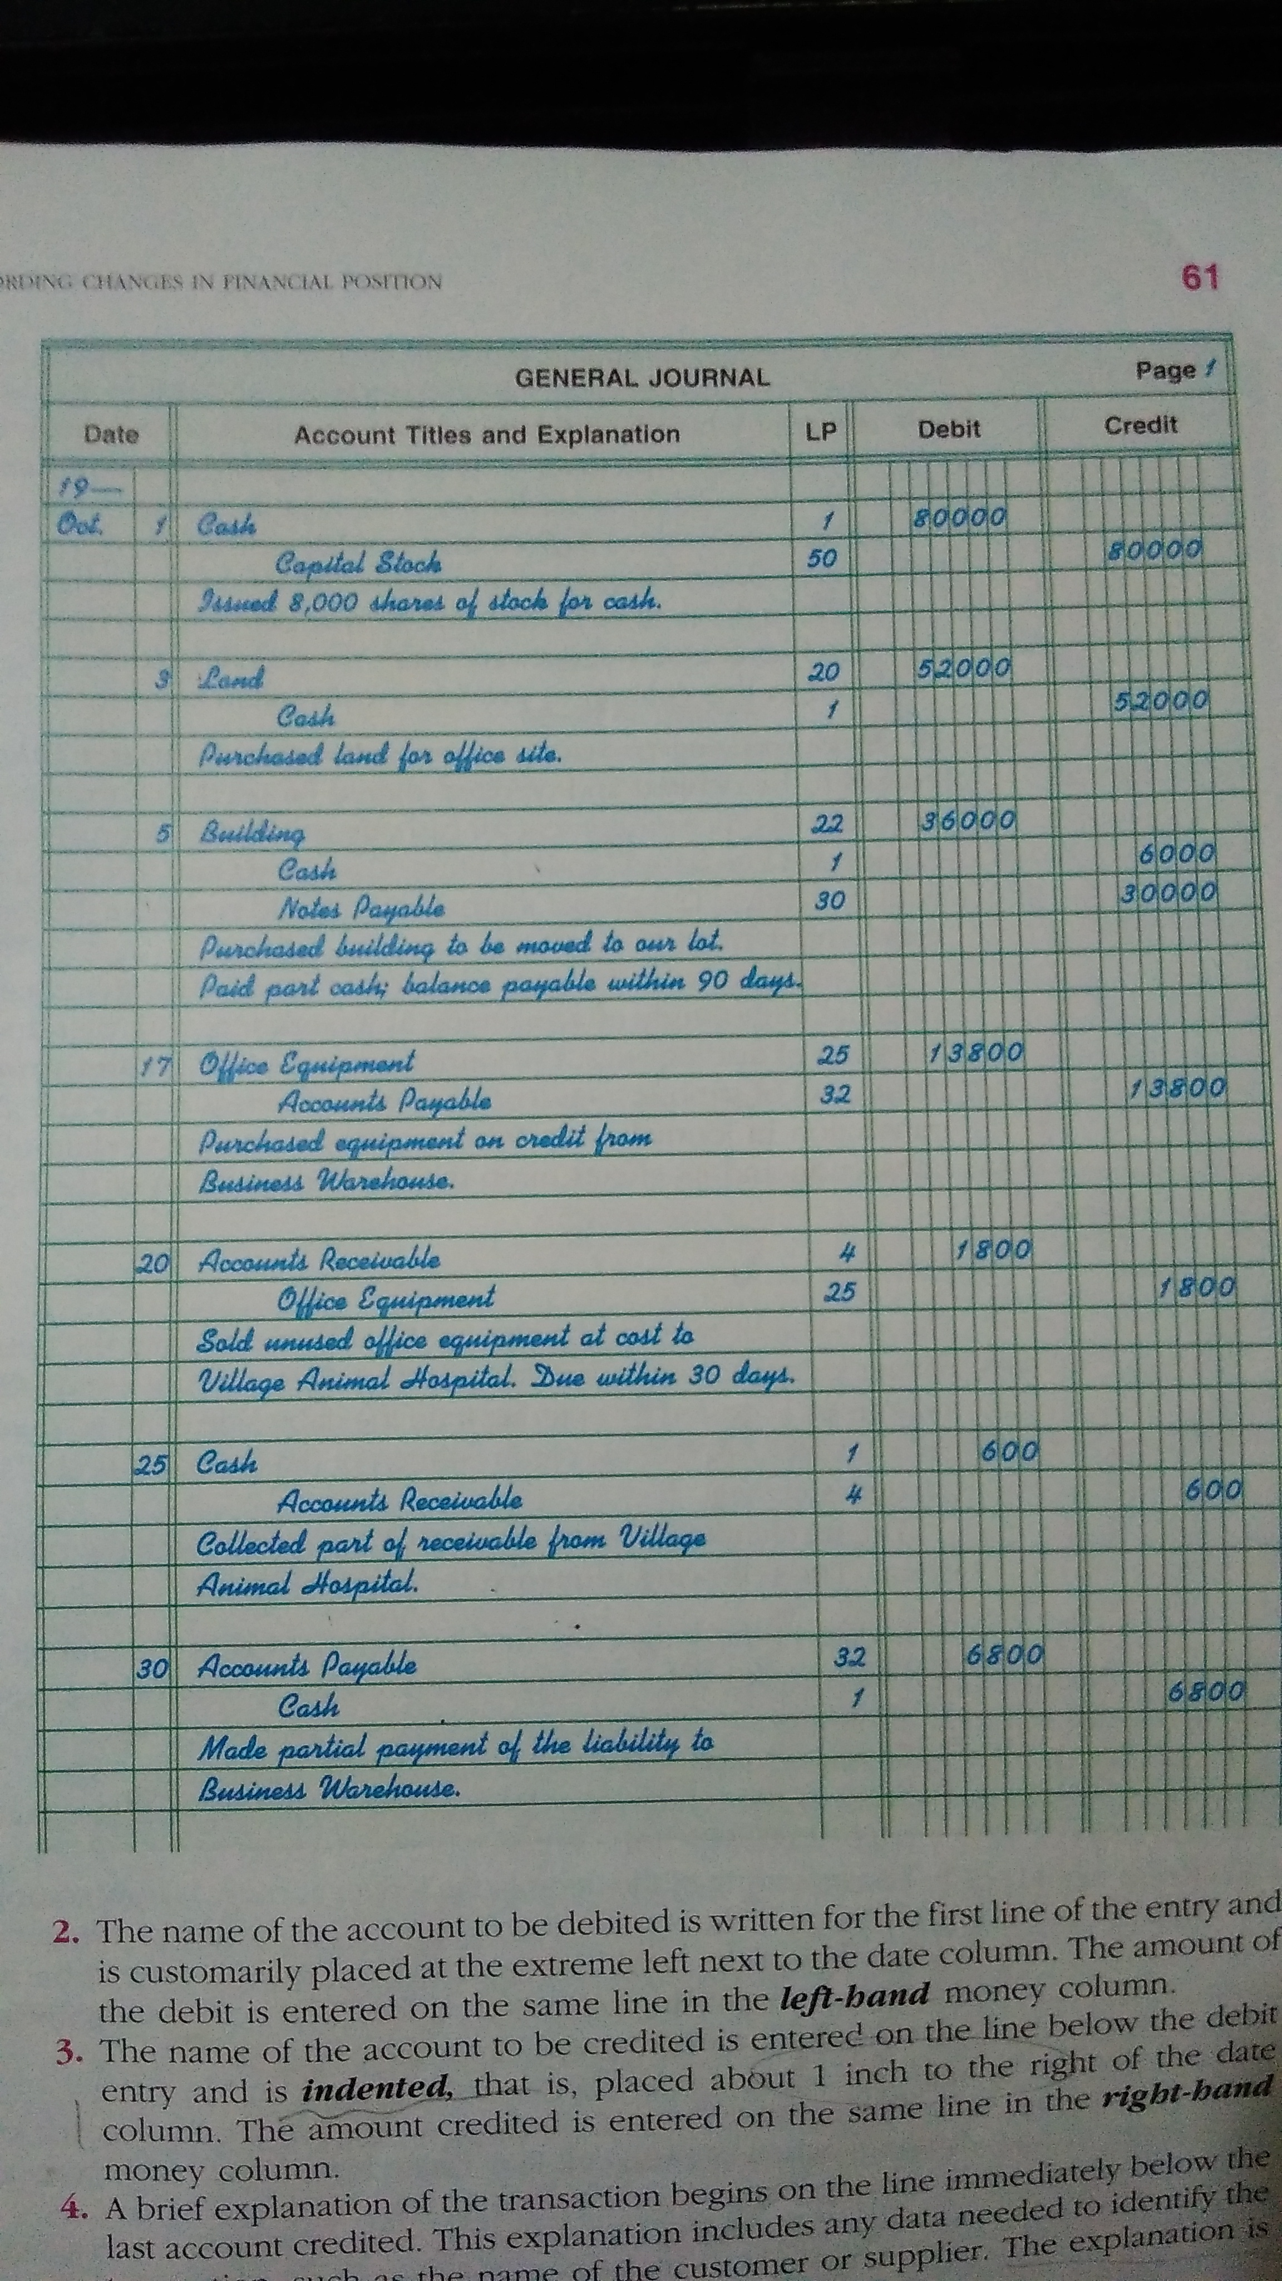
Leger Posting

Slide 21
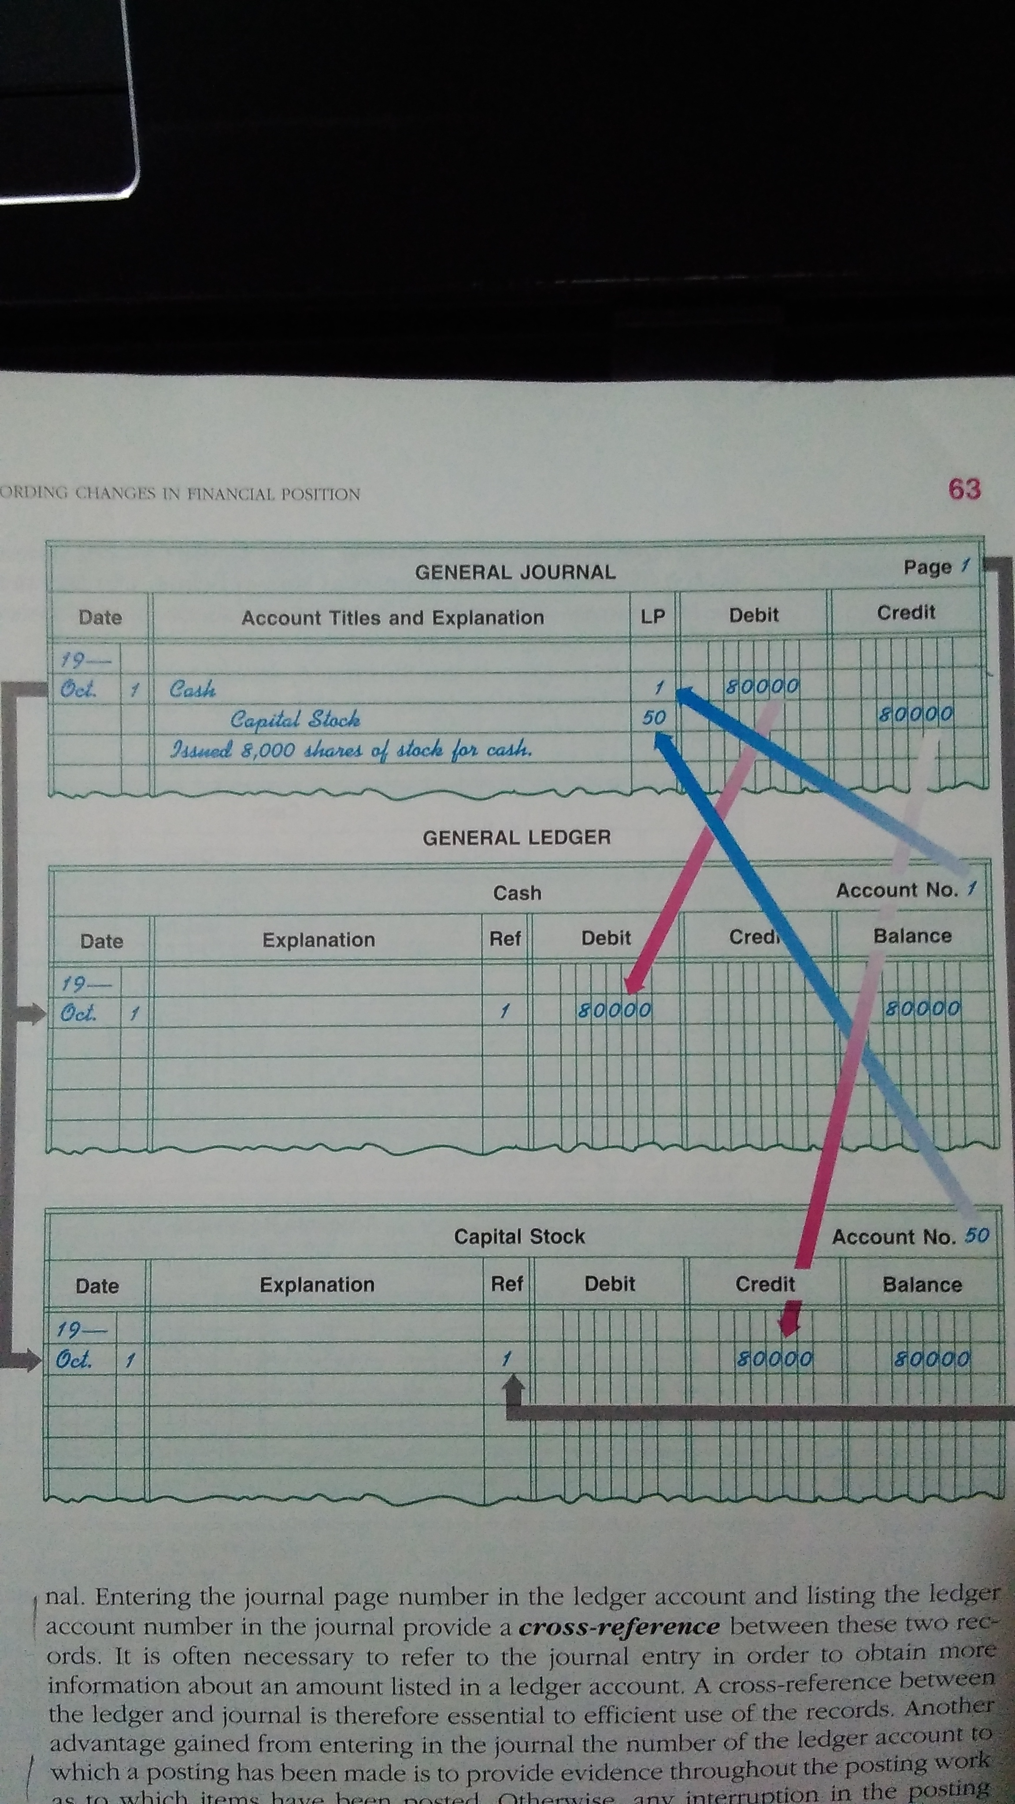
Leger Posting

Slide 22
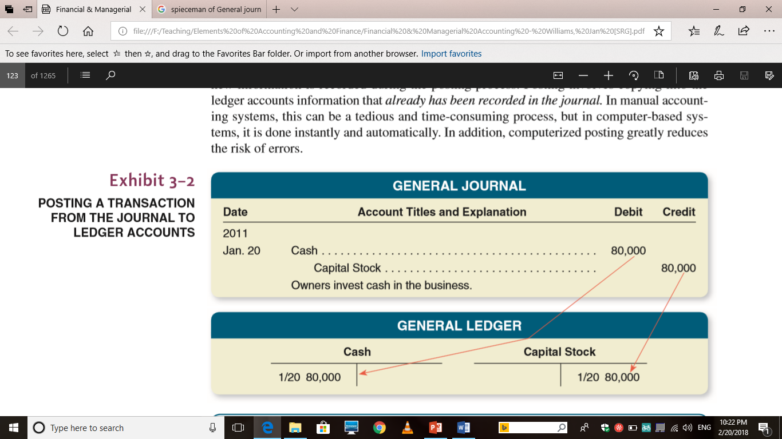
Leger Posting

Slide 23
The Trial Balance
Trial Balance Define The proof of equality of Debit and Credit
A trial balance is a two-column schedule
Listing the names and balances of all the accounts
In the order in which they appear in the ledger
The debit balances are listed in the left-hand column and the credit balances in the right-hand column

Slide 24
Uses and Limitations of The Trial Balance
The trial balance provides proof that the ledger is in balance.
The agreement of the debit and credit totals of the trial balance gives assurance that;
1. Equal debits and credits have been recorded for all transactions.
2. The addition of the account balances in the trial balance has been performed correctly

Slide 25
Uses and Limitations of The Trial Balance
If trial balance is not balanced
It means some errors are made
Typical of such errors are
The posting of a debit as a credit, or vice versa
Arithmetic mistakes in determining account balances
Clerical errors in copying account balances into the trial balance
Listing a debit balance in the credit column of the trial balance, or vice versa
Errors in addition of the trial balance.

Slide 26
Uses and Limitations of The Trial Balance
Trial Balance not guarantee that transactions have been correctly balanced.
In short trial balance proves only one aspect of the ledger that is equality of both side of account,
the debit and credit

Slide 27
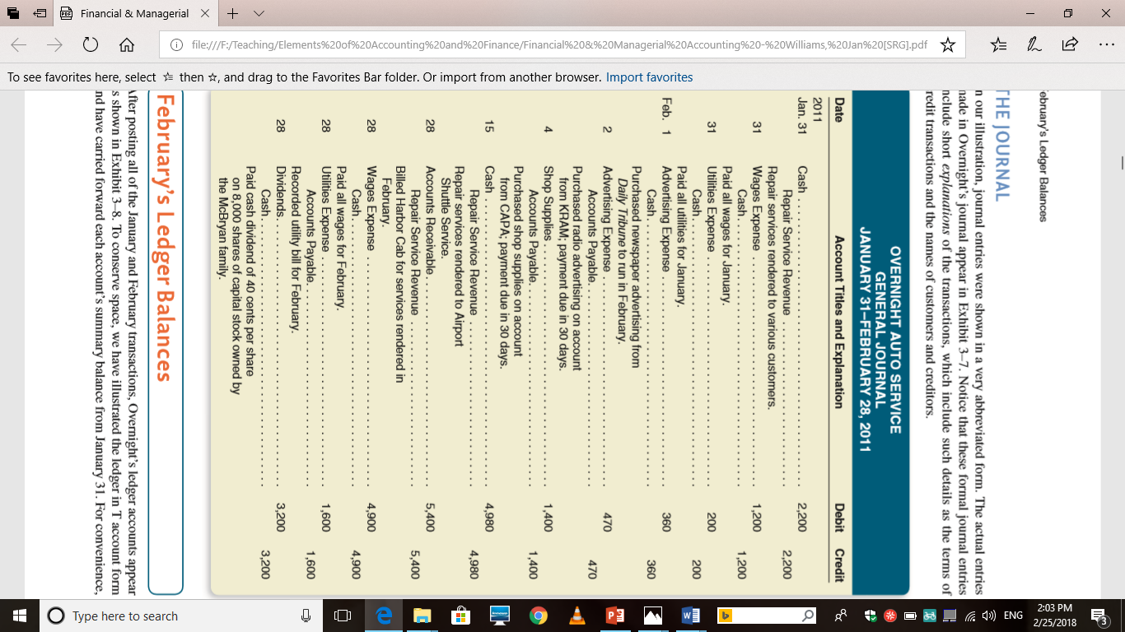
Trial Balance Example

Slide 28
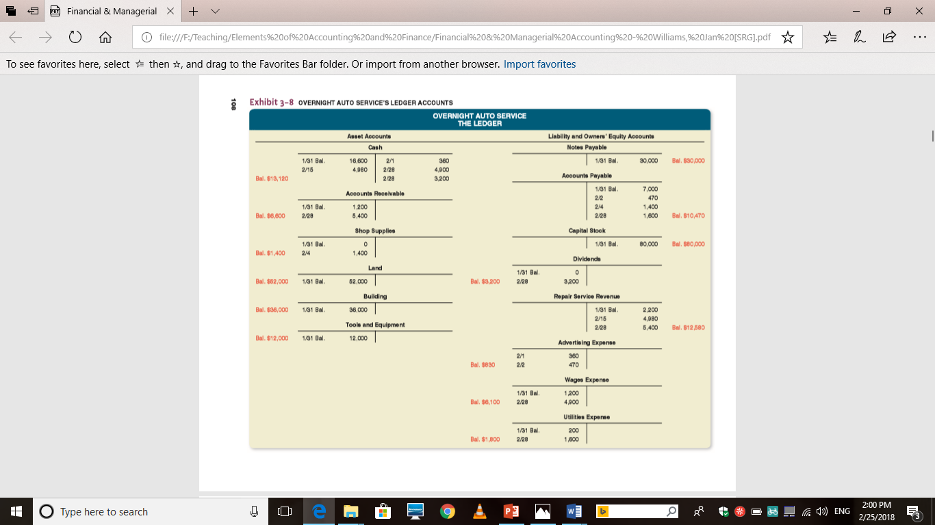
A Comprehensive Example

Slide 29
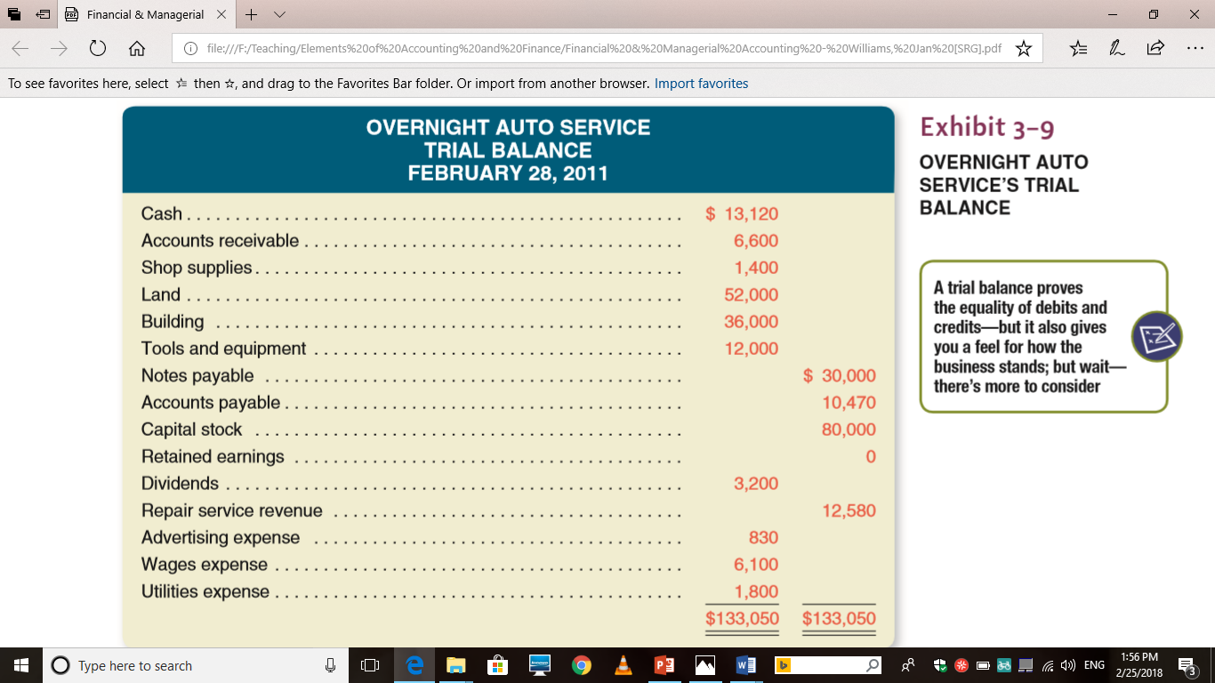
A Comprehensive Example

Slide 30
References
Williams, J. R., Haka, S. F., Bettner, M. S. & Carcello, J. V. (2012) Financial and Managerial Accounting: The basis of business decisions, 16th edition, Mc Graw Hill
Meigs, R. F., & Meigs, W. B., (1998) Financial Accounting, 8th Edition Mc Graw Hill.

Slide 31
Thank You

